Slide 1
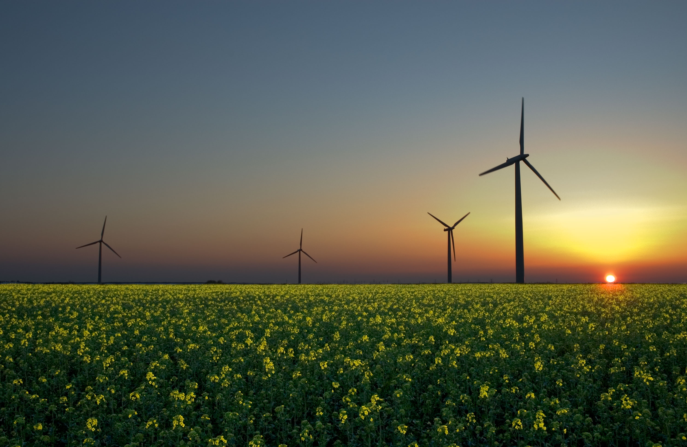
Energy Resources
13
Notes:
We’ll begin with an overview of wind power in the UK….

Slide 2
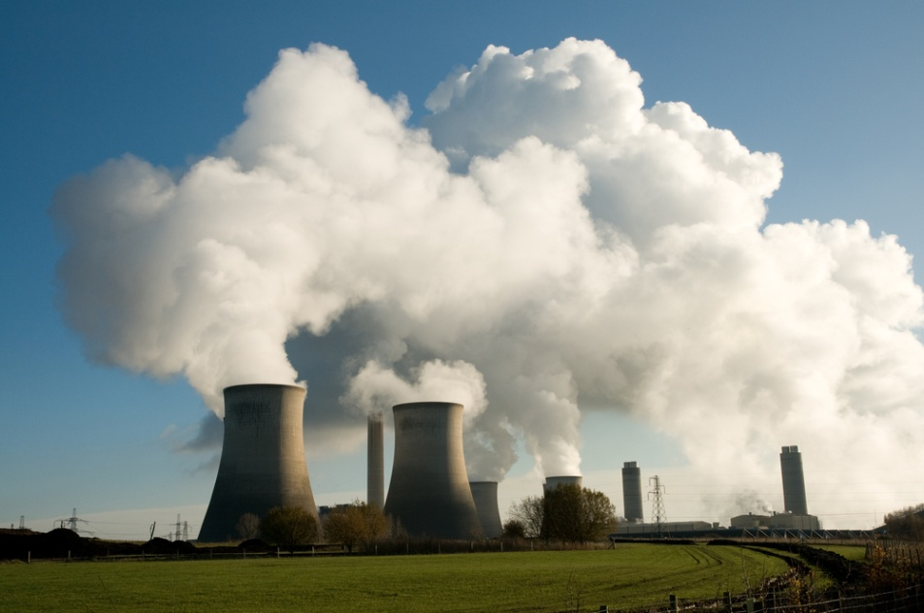
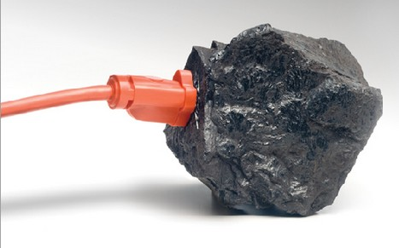
13.1 What Is Net Energy and Why Is It Important?
Net energy yield is the amount of energy obtained from a resource MINUS the amount of energy needed to produce it
Net energy yield values vary greatly depending on the source of energy

Slide 3
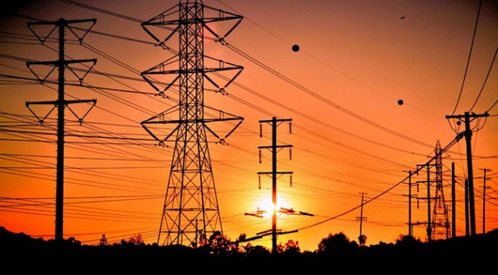
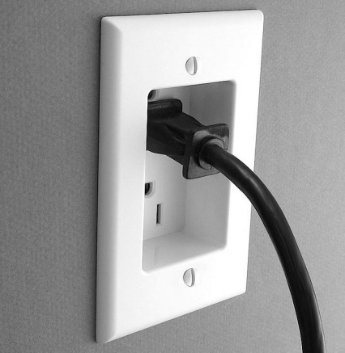
Net Energy Is the Only Energy That Really Counts
Energy input: energy needed to produce energy
Net energy yield = total energy produced – energy required to produce it
Scientists look at net energy yield as the best measure for determining long-term usefulness of an energy resource
If a net energy yield is zero or a negative number – the resource cannot compete in the marketplace

Slide 4
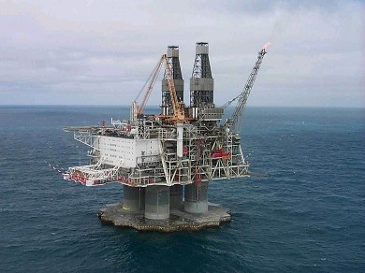
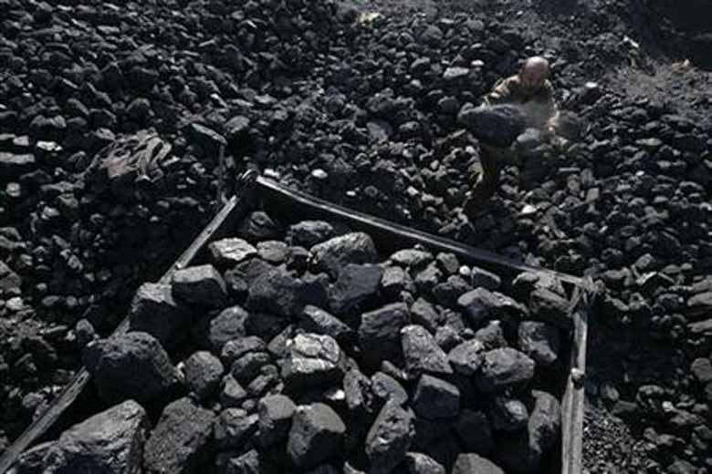
13.2 What Are the Advantages and Disadvantages of Using Fossil Fuel?
Humans use fossil fuels because they are easily available and inexpensive to extract and process
Using these nonrenewable fuels degrades the environment, causes air and water pollution, and releases greenhouse gases into the atmosphere

Slide 5
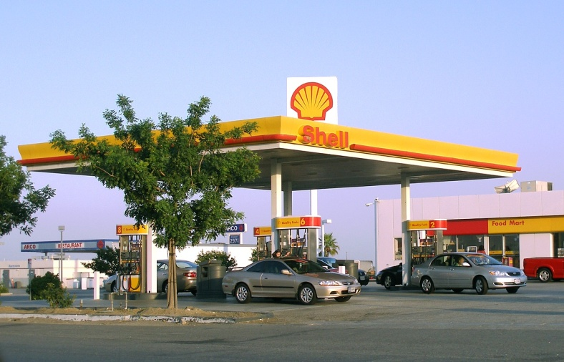
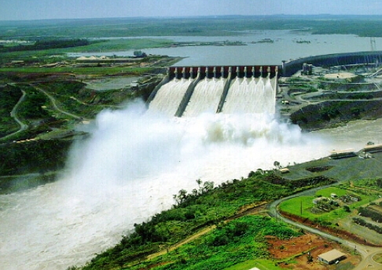
Fossil Fuels Supply Most of Our Commercial Energy
Fossil fuels produce most of our energy, but they are nonrenewable energy – violating the principle of sustainability
Total energy used = 87% fossil fuels, 4% nuclear power, and 9% from renewable sources – biomass, hydropower, geothermal, wind and solar energy
Crude oil/petroleum: formed by pressure applied to decayed organic remains

Slide 6
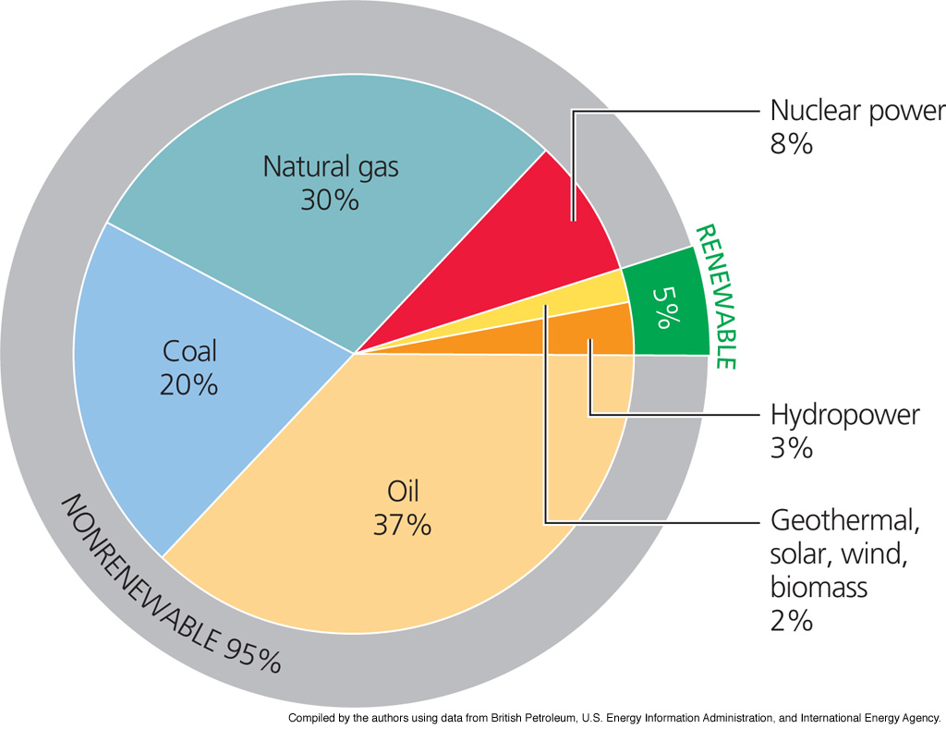
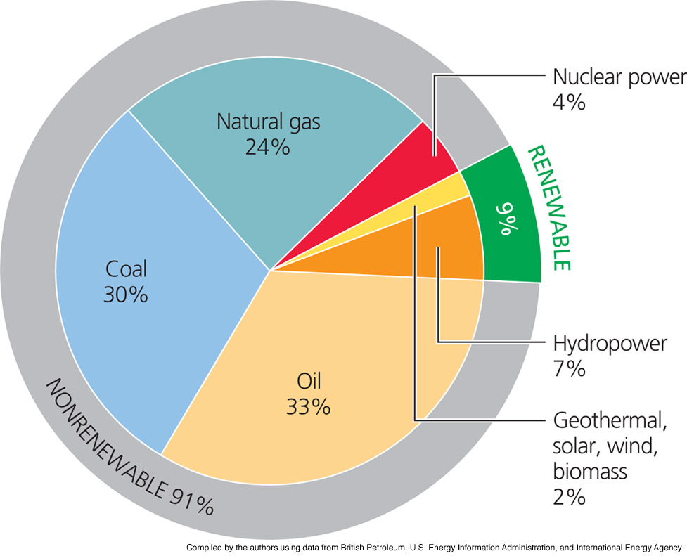
Energy Used By Source
Energy used throughout the World
Energy used by the United States

Slide 7
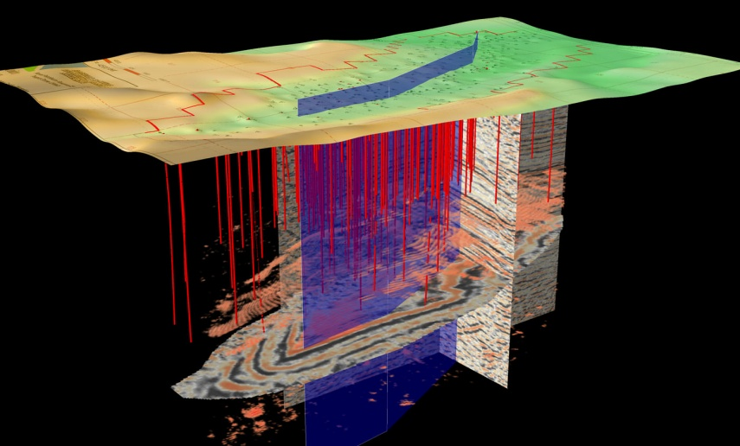
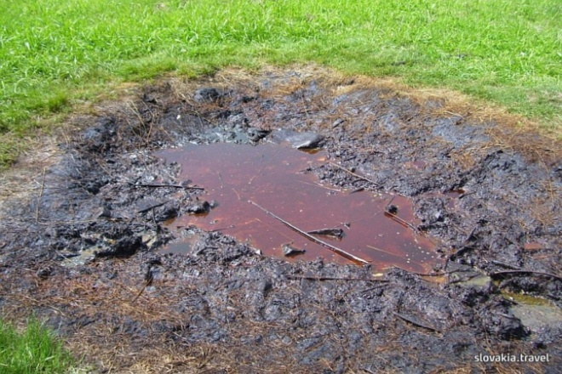
Extracting and Refining Oil
Finding/extracting oil: 3-D seismic maps and computers to find deposits, drill to check deposits, then drill production wells
Peak production: highest return on well – as time passes, production of well declines
Crude oil must be refined to be usable – reduces net energy yield
We will not run out of crude oil in the near future – but the supply is not unlimited

Slide 8
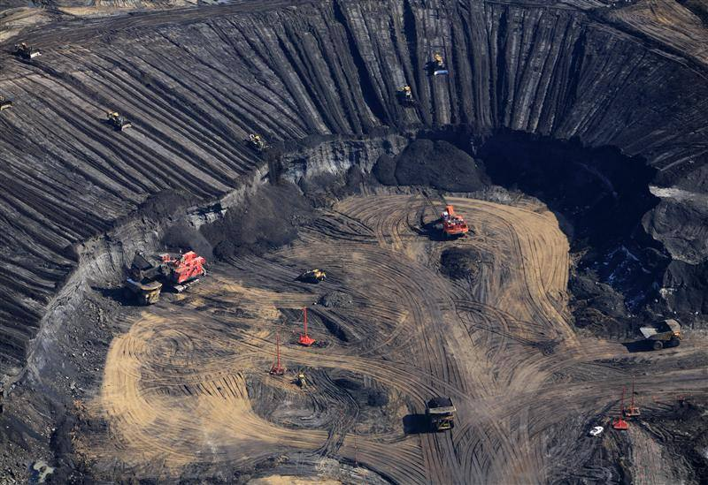
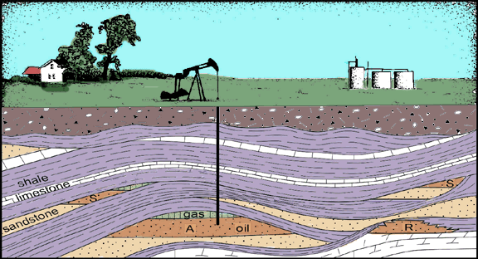
Other Oil Possibilities
Use of oil as an energy resource adds greenhouse gases to the atmosphere and contributes to climate change
Shale oil: oil found within layers of rock
Net energy yield is low – currently not economically viable/harmful to environment
Tar sands/oil sands: oil mixed with clay, sand, water and bitumen – low net energy yield and harmful to environment
Notes:
.

Slide 9
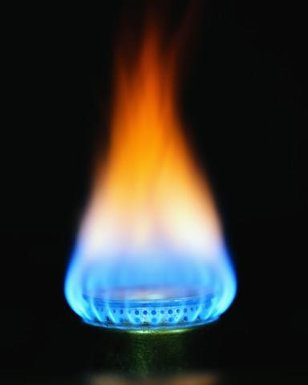
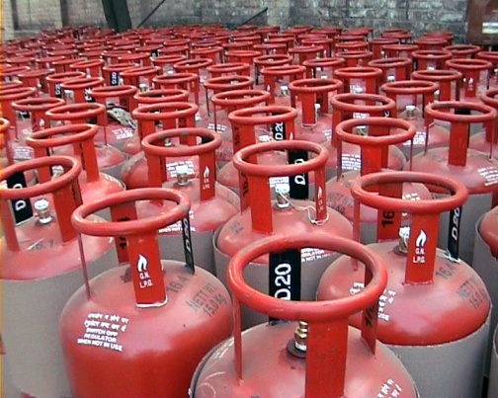
Natural Gas as an Alternative
Natural gas: mixture of gases (50-90% methane) – provides 28% of energy
With a medium net energy yield – used in cooking, heating and industrial purposes; cleaner than oil and coal
Liquefied petroleum gas (propane and butane): tapped from deposits and stored in pressurized tanks
By 2050, U.S. demand will double but supply will be met within U.S. deposits

Slide 10
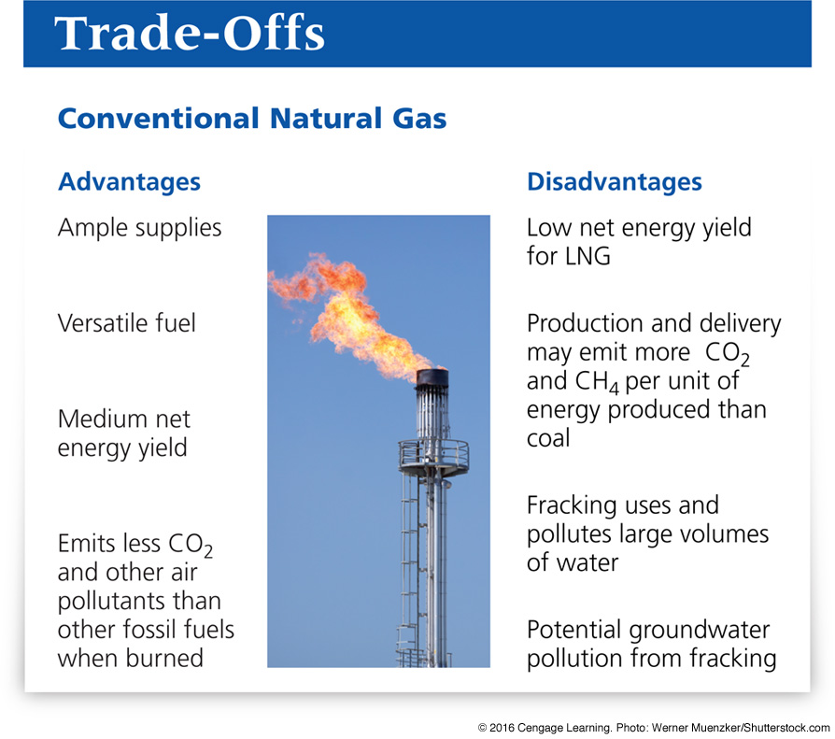
Trade-Offs: Conventional Natural Gas

Slide 11
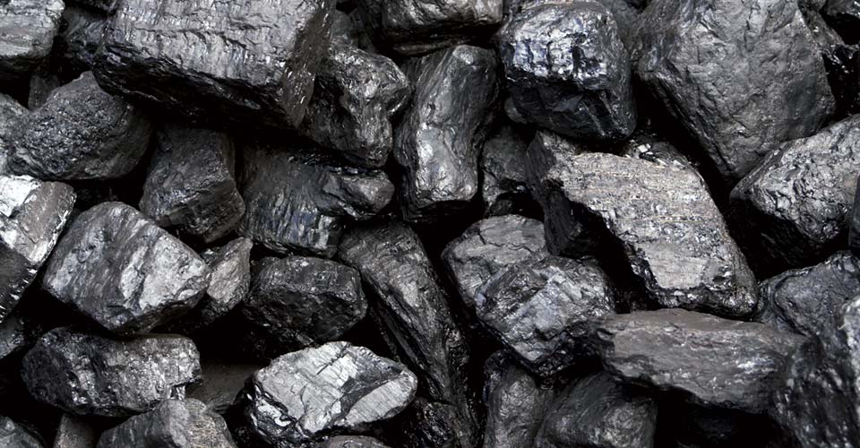
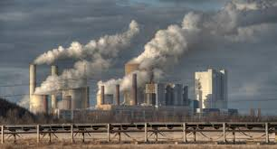
Coal
Coal: solid fossil fuel formed from decaying organic matter exposed to heat and pressure over millions of years
Coal is the dirtiest fossil fuel, polluting air and water
As coal burns, particles are released into the air – contributing to human health problems
Coal burning power/industrial plants – largest emitters of greenhouse gases (39%)

Slide 12
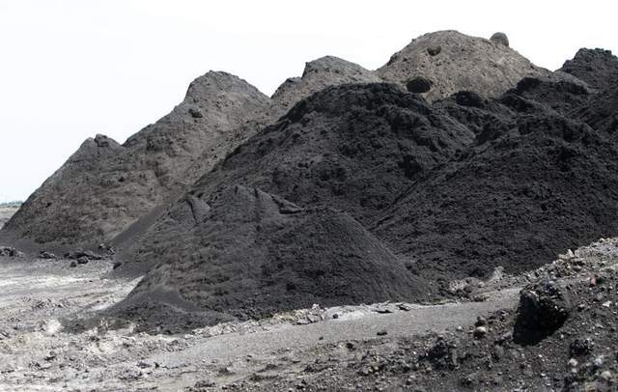
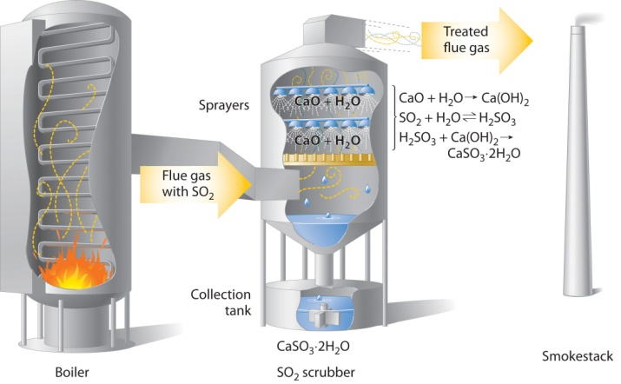
Cost of Coal
Some coal-burning plants use scrubbers to remove pollutants before leaving smoke stacks – this produces toxic coal ash
Some ash is buried, some gets into the water systems, and some is sold for construction –a mix of toxic chemicals
Coal is cheap due to low market pricing
Regulations for usage are needed, but utilities using coal fight regulations and taxes

Slide 13
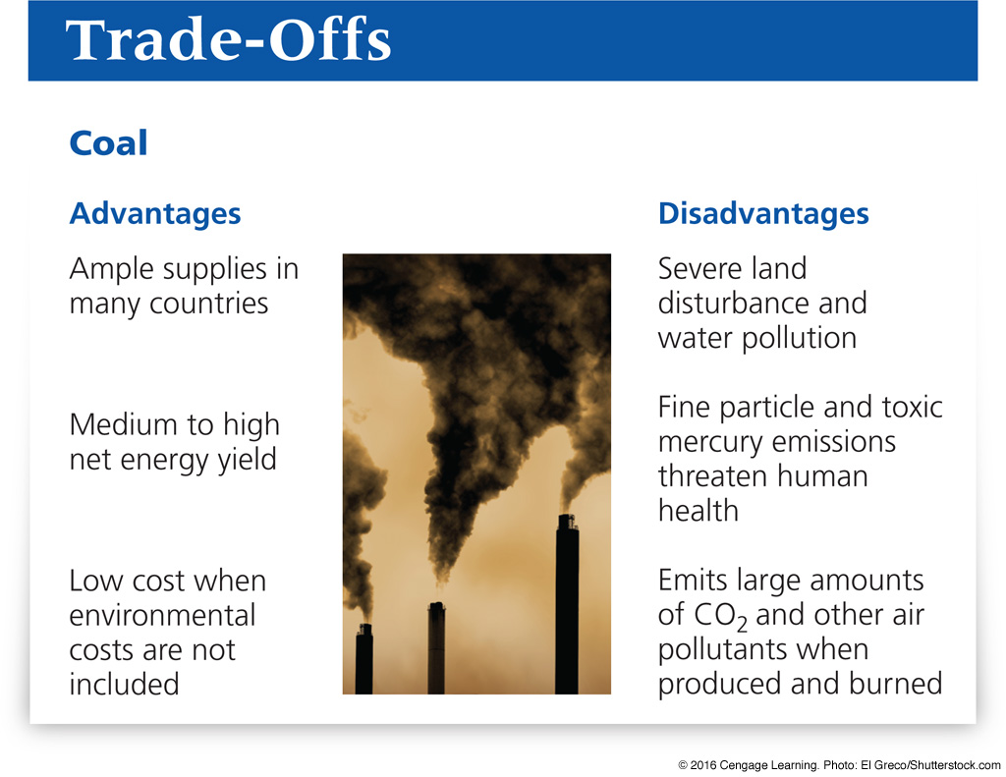
Trade-offs: Advantages and Disadvantages of Coal

Slide 14
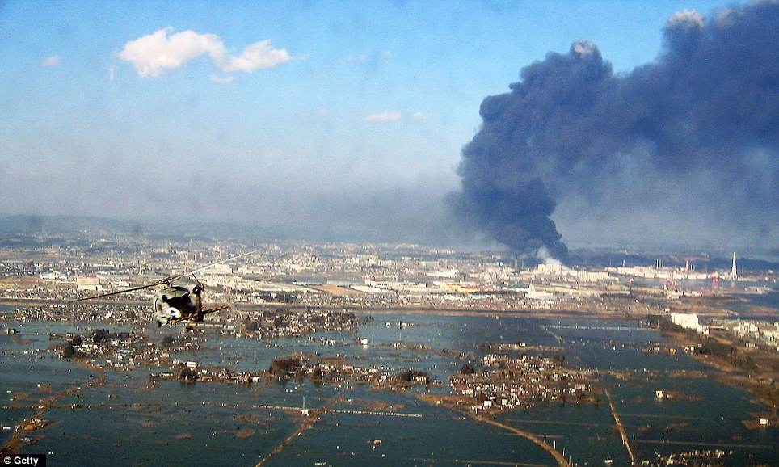
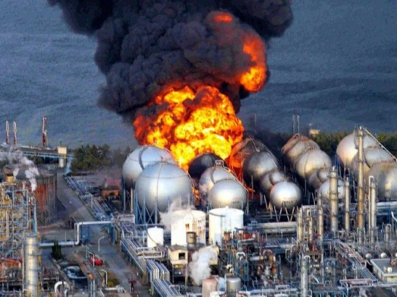
13.3 What Are the Advantages and Disadvantages of Using Nuclear Power?
Nuclear power has little environmental impact and a very low accident risk, but usage is limited due to its low net energy yield
Fear of accidents and the long life of radioactive wastes are also limiting issues

Slide 15
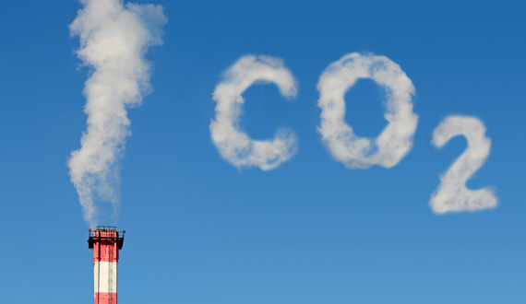
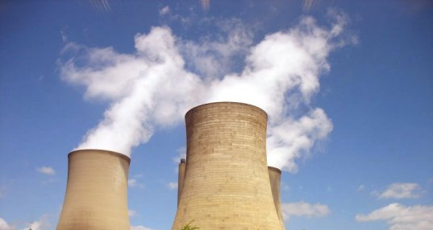
Future of Nuclear Power
Construction and use of nuclear power plants generates CO₂ emissions and contributes to climate change
The prediction that nuclear energy would dramatically replace traditional sources has not occurred
Nuclear power (low net energy yield) is only possible because of government subsidies
Use of new technology (thorium instead of uranium) may change nuclear power development

Slide 16
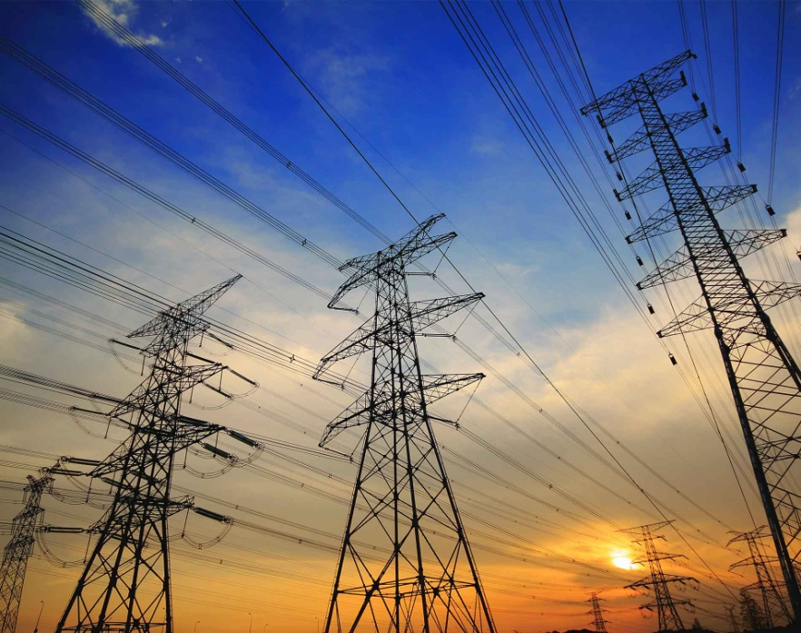

13.4 Why Is Energy Efficiency an Important Energy Resource?
Improved energy efficiency could save1/3 of global energy used and 43% of the energy used in the United States

Slide 17
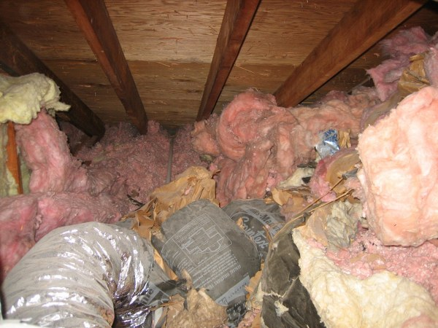

We Use Energy Inefficiently
Energy efficiency: measure of work from each unit of energy, meaning that we need more work for less energy
Poor insulation in badly designed buildings – wastes the energy to heat and cool them
Three out of 4 Americans commute to work (only 5% use mass transit)
Internet data centers (and cloud-based storage) use 10% of electrical energy from grid – other 90% is wasted as heat

Slide 18
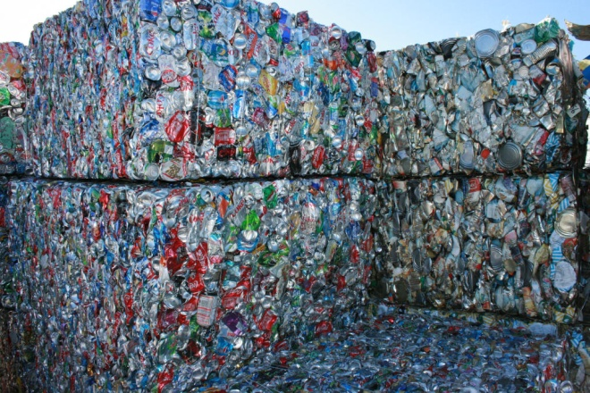
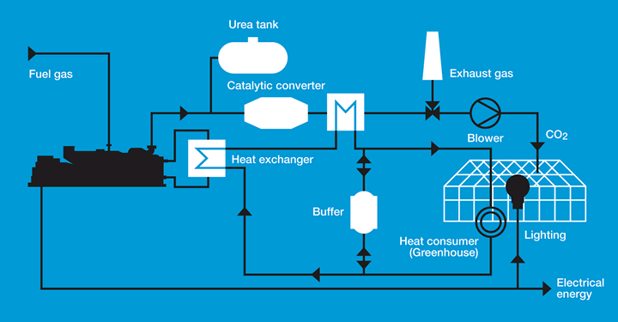
Improving Energy Efficiency
Cogeneration: use a combined heat and power system to recycle steam as heat
Make electric car motors more efficient
Recycle materials, especially steel and other metals
Improve designs of data centers
Convert electrical grids into smart grids
Connect solar and wind power to grids

Slide 19
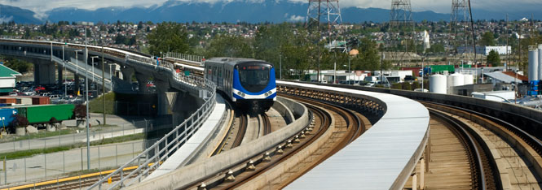

Other Ways To Improve Energy Efficiency
Include hidden costs in market pricing – through higher gas taxes
When hidden costs of gas use are added in, a gallon of gas would be $15 – full-cost pricing
Give consumers tax breaks/subsidies to buy fuel efficient, smaller vehicles
Build/improve mass transit systems
Increase funding for research of hybrid car development and recharging stations

Slide 20
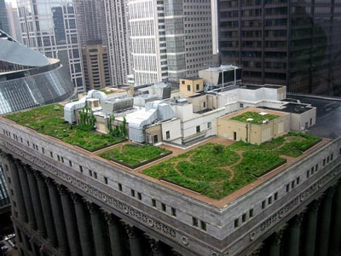
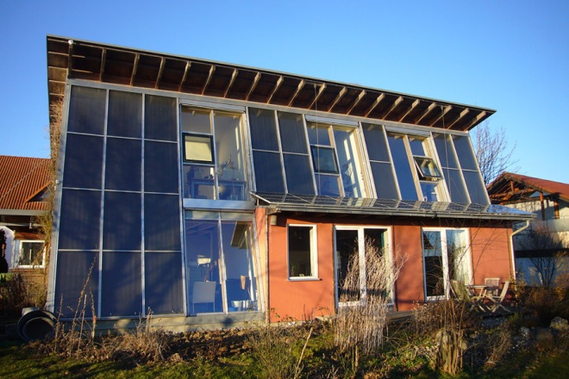
Energy Efficiency and Green Construction
Use principles of sustainability
Build facing sun to use solar power
Green architecture – solar heating, efficient windows, appliances and lighting
Green roofs – soil and vegetation roofs that help insulate a building
Superinsulation (uses 90% less energy) – air tight structures are heated/cooled mainly with sunlight, appliances and body heat

Slide 21


Improving Energy Efficiency in Existing Buildings
To improve efficiency and save money:
Insulate buildings/plug leaks
Use superinsulation, geothermal heat pumps, and solar heating to heat buildings
Heat water more efficiently by using tankless hot water systems/energy saving appliances
Plug electrical devices into smart power strips and don’t leave electronics in standby mode
Use energy-efficient computers and lighting

Slide 22

Why Are We Still Wasting Energy and Money?
Fossil fuels are cheap, but violate full-cost pricing principle of sustainability
Few, if any, economic incentives for encouraging energy efficiency
Lack of public education about energy use
Japan earthquake/tsunami closed nuclear plants – now Japan has replaced ½ its power use by conserving electricity!

Slide 23
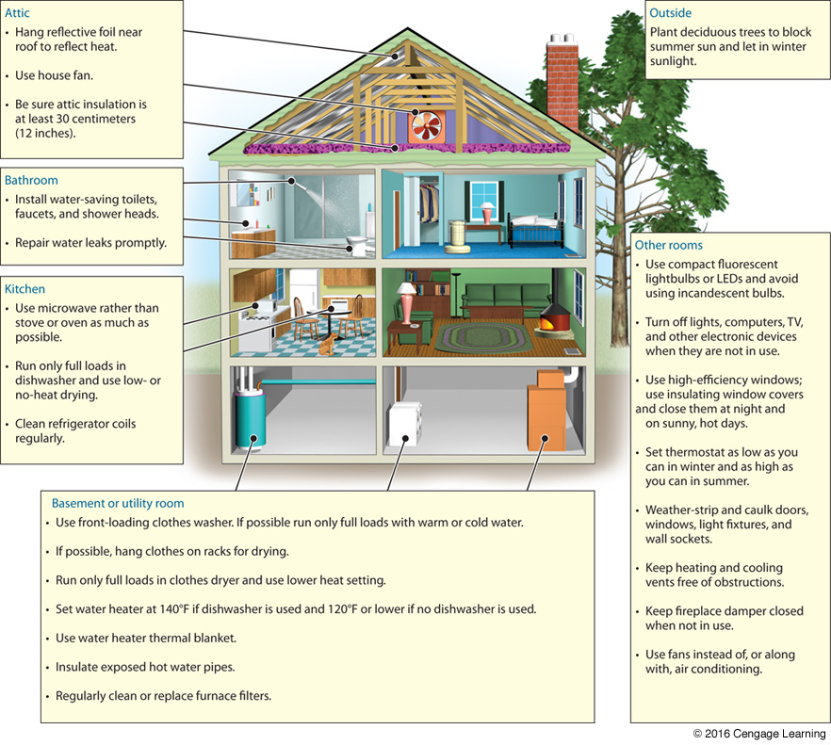
You Can Save Energy and Money Where You Live

Slide 24
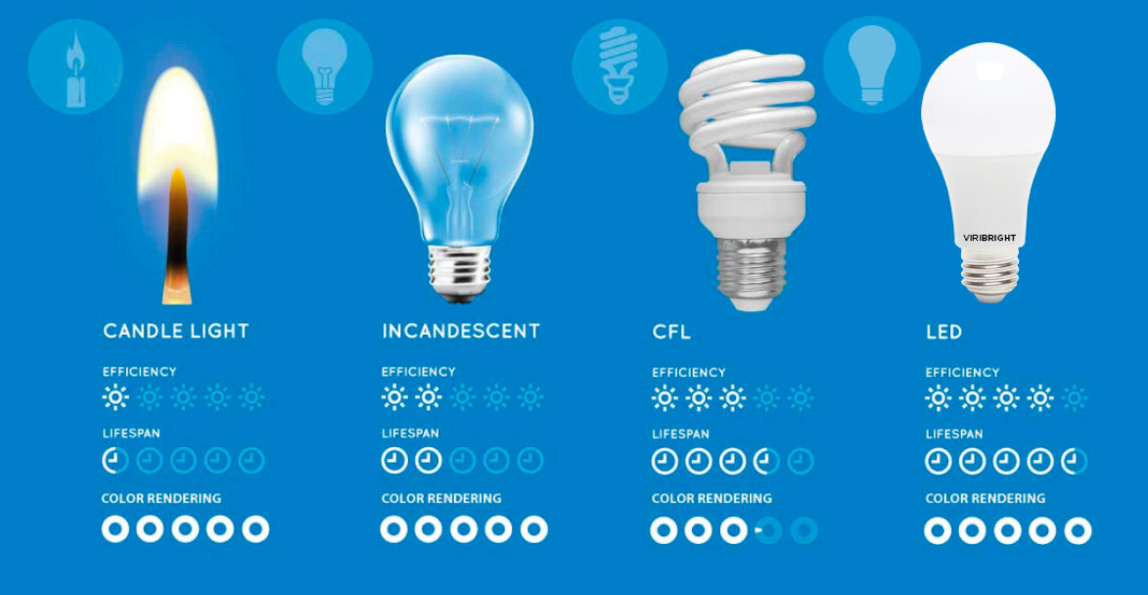
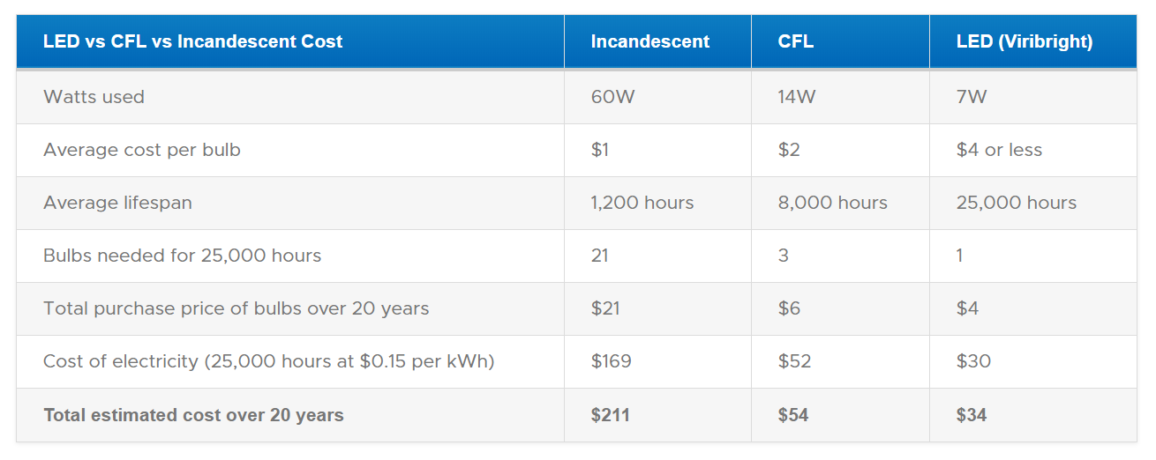
Notes:
25,000 hours of burn time would be if you left a bulb burning it would go for 2.9 years!

Slide 25


13.5 Advantages and Disadvantages of Using Renewable Energy
Using renewable energy resources can meet our energy needs while reducing the effects on the environment – less pollution, greenhouse gas emissions, and biodiversity loss

Slide 26
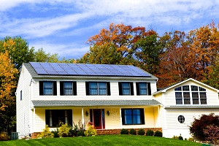
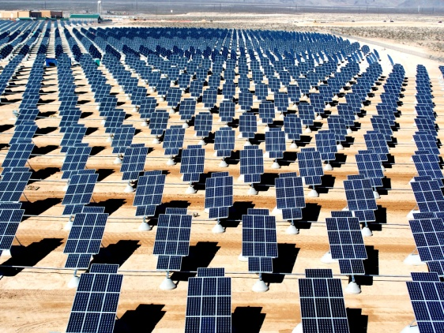
Use of Renewable Energy
Rely on renewable solar and geothermal energy – why are we not using more?
Government financial subsidies for research much less than those for fossil fuels
Subsidies must be renewed more often – resulting in political pressure possibilities
Free-market competition with fossil fuels does not include full-cost pricing
Transitioning from one type of fuel to another takes about 60 years

Slide 27
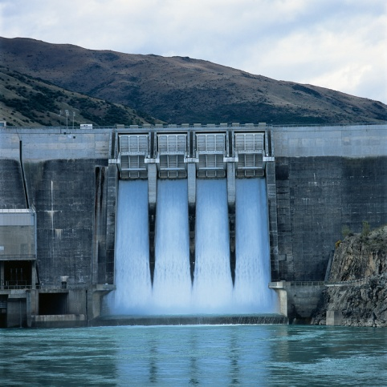
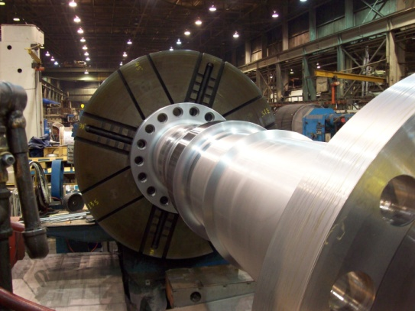
Electricity From Falling and Flowing Water
Hydropower: use of (kinetic energy) falling or flowing water to generate electricity
Building dams, but sediment accumulates behind them and new systems need to be built – decomposing sediments can release greenhouse gases
Only 13% of hydropower potential developed
Microhydropower generators: portable floating turbines that can use a stream or river for power without altering the environment

Slide 28
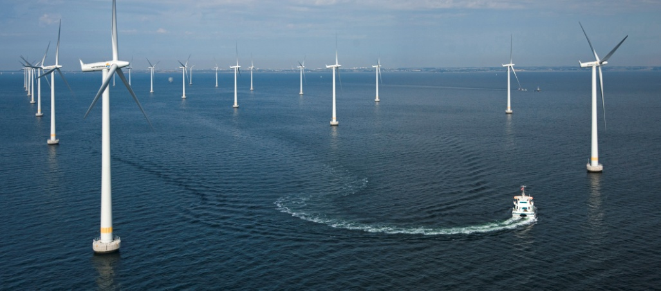
Electricity and Wind Power
Wind power has the potential to produce 40x the current global use of electricity
Onshore wind farms
Offshore wind farms
With subsidy support and smart grids, once in place Atlantic/Gulf Coast wind farms could generate more than enough electricity to replace all of U.S.’s coal fired power plants
Even with full-cost pricing, wind power is the least costly way to produce electricity

Slide 29
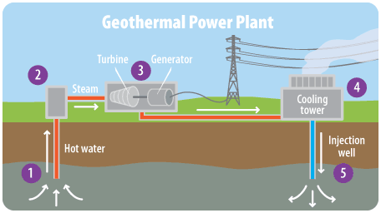
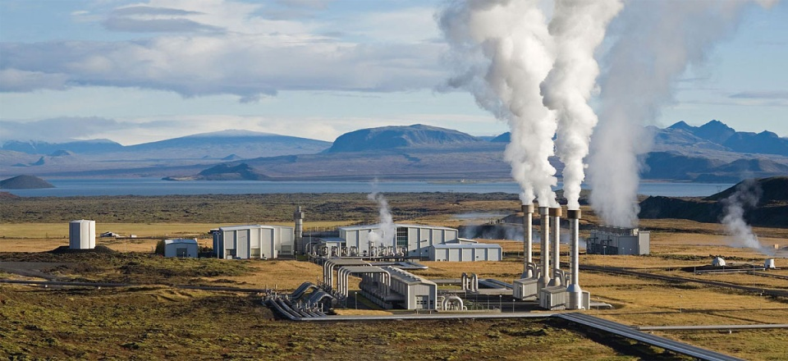
Geothermal Energy
Heat stored in soil, underground rocks and fluids in the earth’s mantle – can be used to heat/cool buildings and produce electricity – and captured by:
Geothermal heat pump systems
Hydrothermal reservoirs of geothermal energy
Hot, dry rocks deep underground

Slide 30


13.6 How Can We Make the Transition To a More Sustainable Energy Future?
Dramatically improve energy efficiency
Use a mix of renewable energy resources
Adjust market prices to include environmental and health costs

Slide 31
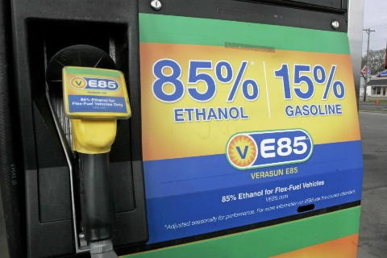
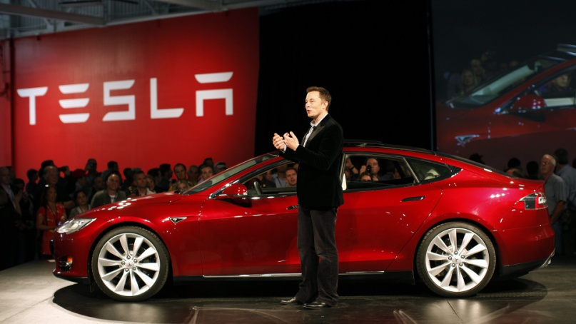
Choosing Energy Paths
Projections suggest:
During this century, there will probably be a gradual shift away from non-renewable fossil fuel use to a mix of renewable energy resources (solar, wind, hydro, geothermal)
Transition best made by improving energy efficiency and regulating the use of natural gas
As fossil fuels are abundant and artificially cheap, they will be used – the key is to reduce harmful environmental and health impacts

Slide 32
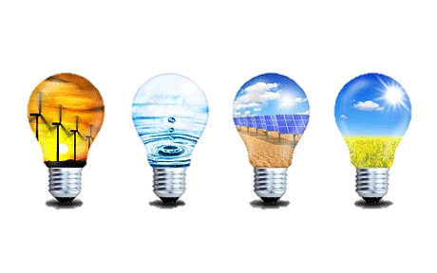
1) Total amount of useful energy from a resource less that amount used and wasted in finding, processing, concentrating, and transporting it to others is called _________.
iClicker Quiz!
Kinetic energy
Potential energy
Net energy yield
Total energy balance
Gross energy
Notes:
C = NET energy

Slide 33
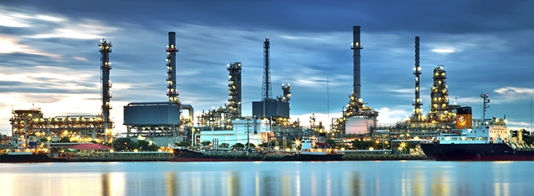
2. The process of heating and separating crude oil into various fuels is known as _____.
iClicker Quiz!
Refining
horizontal drilling
hydraulic fracturing
Fracking
Distillation
Notes:
E = Distillation

Slide 34
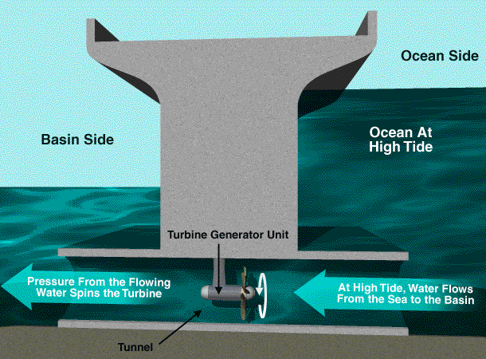
3. ____ is technology that produces energy using kinetic energy of flowing or falling water.
iClicker Quiz!
Wind power
Biomass
Hydropower
Geothermal
Hydrokinesis
Notes:
C = hydropower

